Slide 1
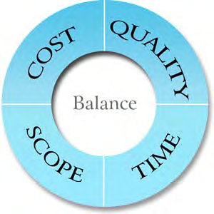
BASICS OF PROJECT MANAGEMENT
Muaz Gultekin
PhD
Muaz.gultekin@gmail.com
Week 1

Slide 2
Senior soldier
ICT24H.NET
Specialties
MCPD
Solution Architect
PhD Candidate
Week 1

Slide 3
What’s Project?
Construct a suspension bridge
Developer software
Implement IT Infrastructure
Landscape the backyard
Launch a new advertising campaign
Move into a new house
Discover a new drug and bring it to market
Build a retirement portfolio
Migrate corporate data to a new server farm
Produce a marketing brochure for new services
Obtain financial aid for your child’s college education
Life is a project. Do you think?
A project is a unique job with a specific goal, clear-cut starting and ending dates, and—in most cases—a budget.
Week 1

Slide 4
All Project Have
An overall goal and unique deliverables.
A project manager.
Individual tasks to be performed between a specific starting point and ending point.
Timing for those tasks to be completed (such as three hours, three days, or three months).
Timing relationships between those tasks (for example, you canft put a new manufacturing process in place until you train people in how to use the process).
Resources (people, equipment, facilities, and supplies, for example) to accomplish the work.
A budget (the costs associated with those people, equipment, facilities, and supplies).
Week 1

Slide 5
What’s Project Management
Project management is simply the process of managing all the elements of a project, whether that project is large or small.
Time = 5 weeks
Cost = $ 10,000 Scope = List of deliverables or features
Quality = Qualities of finished product
Week 1

Slide 6
What Projec Management Isn’t
Project Managemment isn’t personal productivity
Project Management isn’t people management
Project Management isn’t operations or service management
Week 1

Slide 7
Project Life Cycle
Initiating
Planning
Executing
Controlling
Closing
Relationship
Planning
Executing
Controlling

Slide 8
FINDING PROJECTS
Identifying the Opportunities
Compare the Opportunities
Rank and decide

Slide 9
Identifying the Opportunities
Stop
Start
Continue
Get people and discuss together
Stop, Start, Continue Approach
Example
Remove manual work from current processes
Speed up inventory checking
Improve tracking of customer orders, queries and complaints
Allow customers to interact in more ways

Slide 10
Compare the Opportunities
Make more $$$ ????
Increase income (higher sales, new martket, new service)
Decrease cost (cheaper, faster, lower inventory)
Improve productivity (same work done with less time/cost/people)
Reduce risk (increase tax compliance, improve audit score)
Remove manual work ???
Bring new customers ???
Week 1

Slide 11
Ranking your opportunities
Oppotunity | Project | Benefit
Remove manual work from current processes | Combine process analysis and automation | Productivity improvement; cost reduction
Speed up inventory checking | Connect inventory system with existing customer order system | Productivity improvement
Improve tracking of customer order, queries and complaints | Develop additional functionality in the existing customer order system to accommodate queries and complaints tracking | Productivity improvement; increased income
Allow customers to interact in more ways | Introduce customer service website and email address | Increased income
Consider cost carefully
What’s good project
Week 1

Slide 12
Think a good project
It’s important to the future of the organization
Deliver big benefit
Sufficient resources are invested in them
Has supporter within the organization
Week 1

Slide 13
Discovery tool and Practices
Idea elicitation
Portfolio managmenet
Organization building
Big topic
Resource planning
FOCUSING ON
Project Proposals
Value Creation
Week 1

Slide 14
Project Proposals
Outline the potential project
Provide brief background information
Identify the value of undertaking the project
Estimate of the resources (budget, people, time)
Project’s background
Business value
Timing, personal and budget
Project managers will want to obtain from the project proposal
Week 1

Slide 15
Let’s think about them within some minutes
Understanding Project’s background
What problem does the problem solve?
What process does it affect?
Gain a clear explanation of the business value that the project will deliver
Why the project important to the organization?
Ascertain the expectation of the project
Timing
Personnel
Budget
Week 1

Slide 16
Value Creation
Internal rate of return
(IRR)
Direct
Indirect
This project will save $30,000 or the equivalent of 50% of a full-time staff member
Method for calculating
Estimates of time or cost
Approach is used to measure
Net present value
(NPV)
Return on investment
(ROI)
Week 1

Slide 17
PEOPLE OF PROJECT
PROJECT BOARD
PROJECT TEAM
STAKEHOLDER
Week 1

Slide 18
Stakeholder
Disparate group:
Senior management
End user of system
Customer representative
Administrator
…
Who hold a stake in the project – they’re people who care about the project ‘s outcome
Anyone who feels that the project might afect them could regard themselves as a STAKEHOLDER
Defining STAKEHOLDER is important
Week 1

Slide 19
Identifying stakeholder
What business processes are you changing?
Who are the people that are currently executing those business processes?
What are you building?
STAKEHOLDER
How will they be impacted by the chane?
Week 1

Slide 20
Project Board
Make the really big project decisions
Head of department
Project board should consist of:
The project sponsor
A technical advisor
A business advisor
Provide perspective and advice to the project sponsor
Challenge is not to identify the 3 members but to keep the size if board to just 3.
Week 1

Slide 21
Project Team
Considering
Backgrounds
Experiences
Companies
Some questions:
What are their personal motivations?
How do they feel about working on this project?
Are they viewing it as the opportunity of a lifetime or a punishment?
Do they feel they have a needed skill?
Are they worried that they’re out of there depth?
Focus on how they feel about project
What concerns they might have
Share your vision
Week 1

Slide 22
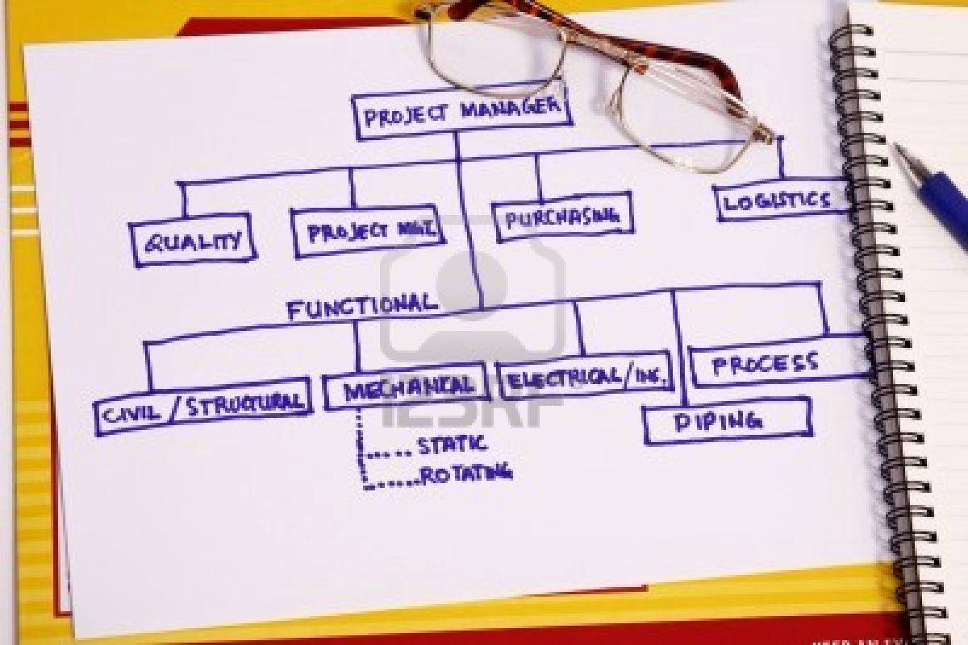
Project Organization Chart
Write down the names of everyone who’s involved in the project
Group according to roles
Chart graphically
Mapping from Project Board
Week 1

Slide 23
Project Board
Name 1
Director
Name 2
IT Manager
Name 3
CS Manager
Marketing
Name 1 (Advisor)
Project Team
Name 1 (PM)
Name 2 (Design)
Name 3 (Database)
Name 4 (Business)
Name 5 (Training)
Customer Service
Name 1 (Advisor)
Sales
Name 1 (Advisor)
IT
Name 1 (Advisor)
Customer base
Represented by Sales and Marketing
Product Supply
Name 1 (Advisor)
Emxample POC Template
Week 1

Slide 24
To be continued…..
Week 1

Slide 25
Generalize Microsoft EPM
Project 2010 delivers new and innovative capabilities across the Microsoft Project family of products: Project Server 2010, Project Professional 2010, and Project Standard 2010.
Week 1

Slide 26
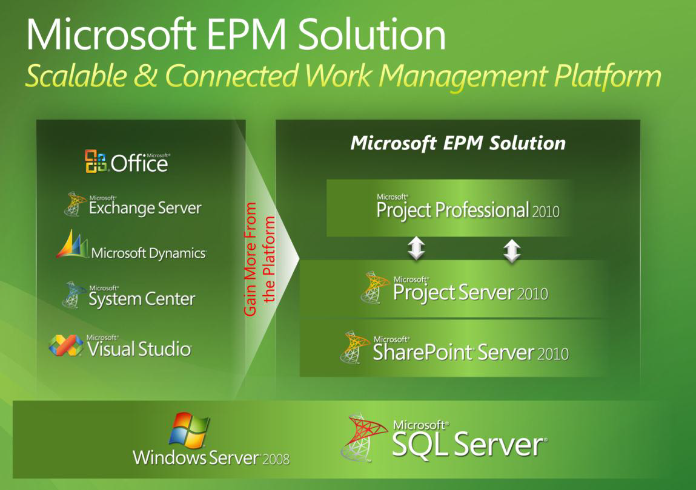

Slide 27
Is Project Server 2010 for only one field?
I will use Project Server 2010 for my personality work.
I want to implement Project Server 2010 for SMB?
……
I can’t install Project Server 2010 in my computer
Week 1

Slide 28
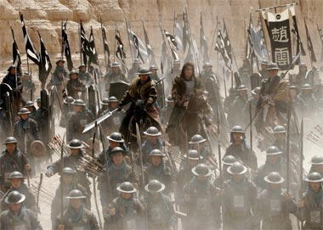
The battle war of projects
My project is beneficial. I do think it brings a huge benefits for organization

Slide 29
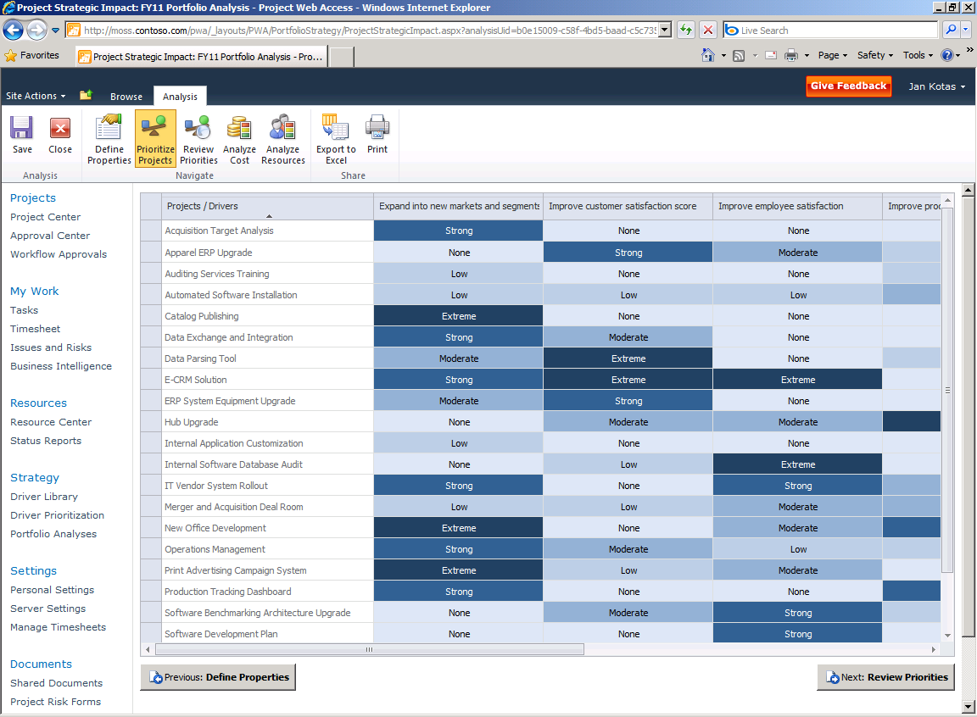
Please calm down !!!
Benefit at here
8 taels
½ kg
Week 1

Slide 30
Project Strategic
Impact view
The primary purpose of the matrix is to derive a priority score for competing requests.
Week 1

Slide 31
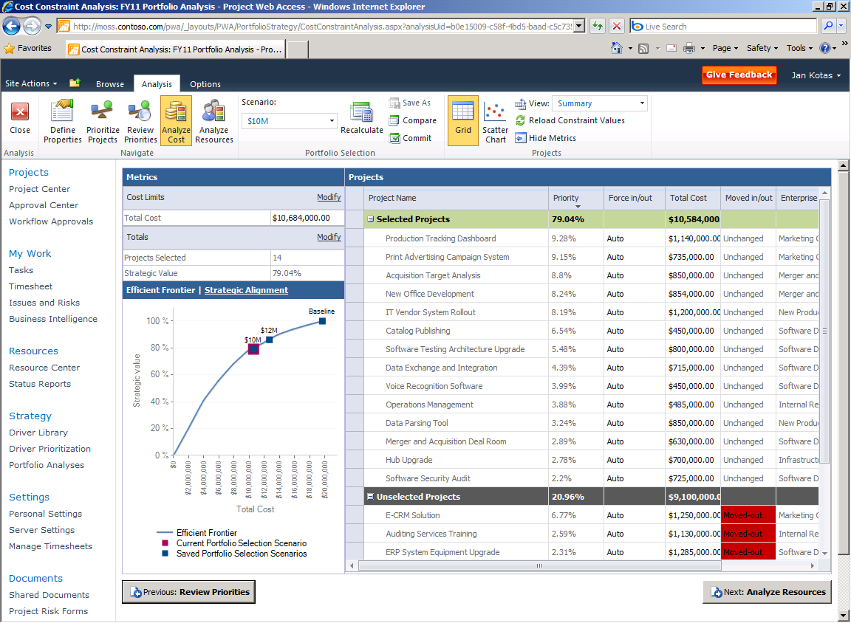
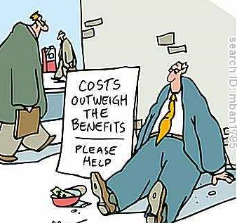
Analyze cost
Selected Projects and Unselected Projects
Week 1

Slide 32
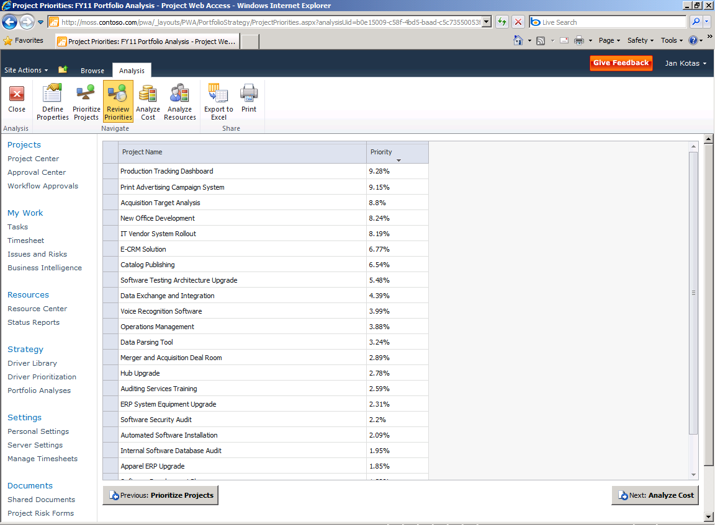
Week 1

Slide 33
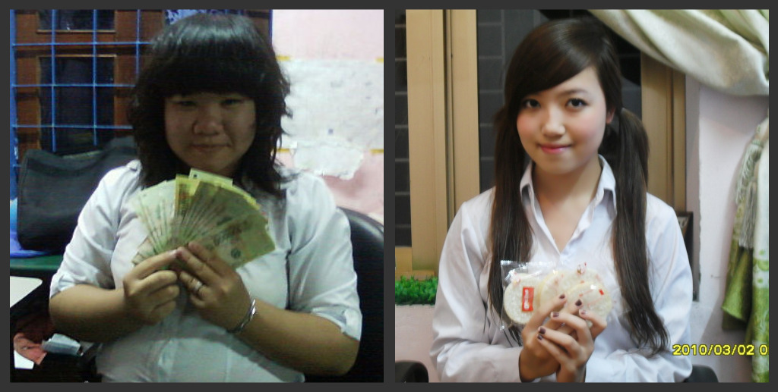
Credit Score
1000
Credit Score
850
Week 1

Slide 34
Project A is selected
Oh my goodness !!!
Calm down !!!
Week 1

Slide 35
Thank you for attending
Learn Project 2010 Professional and Basics of Project Server 2010 Administration
http://sharepointvn.net/category/epm
Thuan Nguyen – ICT24H Team
Email: nguyenthuan@ict24h.net
Home: http://ict24h.net
Week 1

