Slide 1
Movie-Youtube
What is Project

Slide 2
What is Project?
A project is a temporary endeavor with a defined beginning and end (usually time-constrained, and often constrained by funding or deliverables),^{[1]}undertaken to meet unique goals and objectives,^{[2]} typically to bring about beneficial change or added value

Slide 3
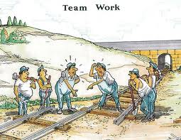
Situational Analysis? Why Project Management
Picture Problem
Notes:
Use Flash Card –Red and Green
1.Write on Red one word – Problem .ie. Planning, goal setting, Monitoring, Communication
2. Write on Green Card –one word solutions ie. Planning, goal setting, Monitoring, Communication

Slide 4
Situational Analysis? Class work
Write on Red Flash Card one word – Problem
Write on Green Flash Card one word the Solutions
Tag it on the Soft Board
Picture Problem
Notes:
Use Flash Card –Red and Green
1.Write on Red one word – Problem .ie. Planning, goal setting, Monitoring, Communication
2. Write on Green Card –one word solutions ie. Planning, goal setting, Monitoring, Communication

Slide 5
Why project and Why management?
Question?
Brainstorming Session
Notes:
Use Flip Chat

Slide 6
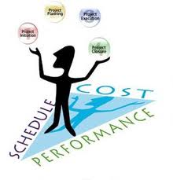
What is Project Management?
Project management is the discipline of planning, organizing, securing, and managing resources to achieve specific goals.

Slide 7
What is project management?
Which one?

Slide 8
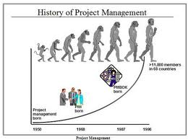
History of Project management?
Notes:
Use Flip Chat

Slide 9
Movie-Youtube
History of Project Management
http://www.youtube.com/watch?feature=player_detailpage&v=C1uxCBx2-UQ

Slide 10
Case Study – Youtube Assignment (Individual)
Building the Great Pyramid was Based on Project Management
Debate: WAS or Was NOT
Assignment-1
http://www.youtube.com/watch?feature=player_detailpage&v=C1uxCBx2-UQ
Notes:
Use Flip Chat

Slide 11
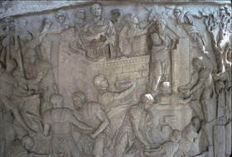
History of Project Management
Roman soldiers building a fortress, Trajan's Column113 AD
Any Example – you know?
Project management has been practiced since early civilization.
Until 1900 civil engineering projects were generally managed by creative architects, engineers, and master builders themselves, among those for
example Vitruvius (1st century BC),Christopher Wren (1632–1723), Thomas Telford (1757–1834) and Isambard Kingdom Brunel (1806–1859)

Slide 12
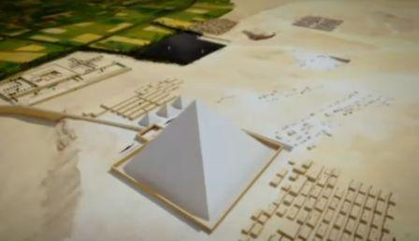

Slide 13
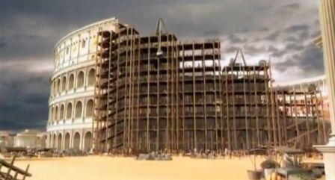

Slide 14
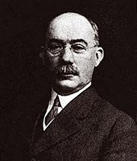
History of Project Management
It was in the 1950s that organizations started to systematically apply project management tools and techniques to complex engineering projects
As a discipline, Project Management developed from several fields of application including civil construction, engineering, and heavy defense activity.^{[8]}
Two forefathers of project management are Henry Gantt, called the father of planning and control techniques,^{[9]} who is famous for his use of the Gantt chart as a project management tool; and Henri Fayol for his creation of the 5 management functions which form the foundation of the body of knowledge associated with project and program management
Gantt and Fayol were students of Frederick Winslow Taylor's theories of scientific management. His work is the forerunner to modern project management tools including work breakdown structure (WBS) and resources

Slide 15
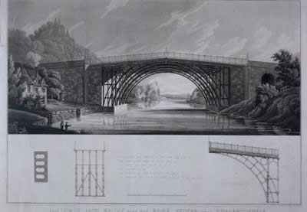
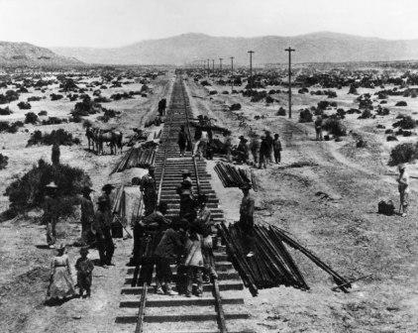

Slide 16
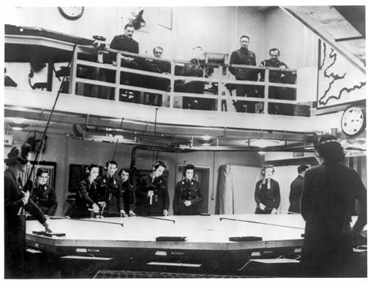

Slide 17
History of Project Management
The 1950s marked the beginning of the modern Project Management era where core engineering fields come together working as one. Project management became recognized as a distinct discipline arising from the management discipline with engineering model.^{[11]}
In the United States, prior to the 1950s, projects were managed on an ad hoc basis using mostly Gantt Charts, and informal techniques and tools. At that time, two mathematical project-scheduling models were developed.
The "Critical Path Method" (CPM) was developed as a joint venture between DuPont Corporation and Remington Rand Corporation for managing plant maintenance projects.
The "Program Evaluation and Review Technique" or PERT, was developed by Booz Allen Hamilton as part of the United States Navy's (in conjunction with the Lockheed Corporation) Polaris missile submarine program;^{[12]}
These mathematical techniques quickly spread into many private enterprises.

Slide 18
Food for though?
How all the individual fit in PM
Some Examples from Participants
The big picture of the subject
Text
Text
Text
Text
Text
Text
Text
Text

Slide 19
Situational Analysis? Project vs Program Management
Picture Problem
Notes:
Use Flash Card –Red and Green
1.Write on Red one word – Problem .ie. Planning, goal setting, Monitoring, Communication
2. Write on Green Card –one word solutions ie. Planning, goal setting, Monitoring, Communication

Slide 20
What is Program Management Project vs Program Management
Some Example of Project vs Program management
Media and Communication Industry
i.e GEO TV, program Kamran Khan
2. Social Development
i.e UNDP and INGOs program and Projects
Notes:
Use Flash Card one word

Slide 21
Project Management terminologies
Questions
How many you know?
Notes:
Ask participants how many you know no. and name and explain

Slide 22
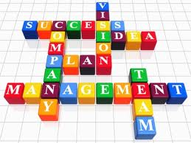
Vocabulary
Glossary of terms
Define the terms as used in this training

Slide 23
Movie-Youtube
Project Management Terminologies
http://www.youtube.com/watch?feature=player_profilepage&v=KVIqrUz76jw

Slide 24
Project management terminology
Aggregate planning is an operational activity which does an aggregate plan for the production process, in advance of 2 to 18 months, to give an idea to management as to what quantity of materials and other resources are to be procured and when, so that the total cost of operations of the organization is kept to the minimum over that period.
Allocation is the assignment of available resources in an economic way.
Budget generally refers to a list of all planned expenses and revenues.
Budgeted cost of work performed (BCWP) measures the budgeted cost of work that has actually been performed, rather than the cost of work scheduled.
Budgeted cost of work scheduled (BCWS) the approved budget that has been allocated to complete a scheduled task (or Work Breakdown Structure (WBS) component) during a specific time period.

Slide 25
Project management terminology
Change control is a general term describing the procedures used to ensure that changes (normally, but not necessarily, to IT systems) are introduced in a controlled and coordinated manner. Change control is a major aspect of the broader discipline of change management.
Change management is a field of management focused on organizational changes. It aims to ensure that methods and procedures are used for efficient and prompt handling of all changes to controlled IT infrastructure, in order to minimize the number and impact of any related incidents upon service.
Case study is a research method which involves an in-depth, longitudinal examination of a single instance or event: a case. They provide a systematic way of looking at events, collecting data, analyzing information, and reporting the results.
Costs in economics, business, and accounting are the value of money that has been used up to produce something, and hence is not available for use anymore. In business, the cost may be one of acquisition, in which case the amount of money expended to acquire it is counted as cost.
Cost overrun is defined as excess of actual cost over budget.

Slide 26
Project management terminology
Critical path method (CPM) is a mathematically based modeling technique for scheduling a set of project activities, used in project management.
Critical chain project management (CCPM) is a method of planning and managing projects that puts more emphasis on the resources required to execute project tasks.
Duration of a project's terminal element is the number of calendar periods it takes from the time the execution of element starts to the moment it is completed.
Deliverable A contractually required work product, produced and delivered to a required state. A deliverable may be a document, hardware, software or other tangible product.
Earned schedule (ES) is an extension to earned value management (EVM), which renames two traditional measures, to indicate clearly they are in units of currency or quantity, not time.

Slide 27
Project management terminology
Earned value management (EVM) is a project management technique for measuring project progress in an objective manner, with a combination of measuring scope, schedule, and cost in a single integrated system.
Effort management is a project management subdiscipline for effective and efficient use of time and resources to perform activities regarding quantity, quality and direction.
Estimation in project management is the processes of making accurate estimates using the appropriate techniques.
Event chain methodology is an uncertainty modeling and schedule network analysis technique that is focused on identifying and managing events and event chains that affect project schedules.
Extreme project management (XPM) refers to a method of managing very complex and very uncertain projects.

Slide 28
Project management terminology
Float in a project network is the amount of time that a task in a project network can be delayed without causing a delay to subsequent tasks and or the project completion date.
Focused improvement in Theory of Constraints is the ensemble of activities aimed at elevating the performance of any system, especially a business system, with respect to its goal by eliminating its constraints one by one and by not working on non-constraints.
Fordism, named after Henry Ford, refers to various social theories. It has varying but related meanings in different fields, and for Marxist and non-Marxist scholars.
Henry Gantt was an American mechanical engineer and management consultant, who developed the Gantt chart in the 1910s.
Gantt chart is a type of bar chart that illustrates a project schedule. It illustrate the start and finish dates of the terminal elements and summary elements of a project. Terminal elements and summary elements comprise the work breakdown structure of the project.

Slide 29
Project management terminology
Goal or objective consists of a projected state of affairs which a person or a system plans or intends to achieve or bring about — a personal or organizational desired end-point in some sort of assumed development. Many people endeavor to reach goals within a finite time by setting deadlines
Goal setting involves establishing specific, measurable and time targeted objectives
Graphical Evaluation and Review Technique (GERT), is a network analysis technique that allows probabilistic treatment of both network logic and activity duration estimated.
Hammock activity is a schedule (project management) or project planning term for a grouping of subtasks that "hangs" between two end dates it is tied to. (Or the two end-events it is fixed to.)
HERMES is a Project Management Method developed by the Swiss Government, based on the German V-Modell. The first domain of application was software projects.

Slide 30
Project management terminology
Integrated Master Plan (IMP) is an event-based, top level plan, consisting of a hierarchy of Program Events.
ISO 10006 is a guidelines for quality management in projects, is an international standard developed by the International Organization for Standardization.
Kickoff meeting is the first meeting with the project team and the client of the project.
Level of Effort (LOE) is qualified as a support type activity which doesn't lend itself to measurement of a discrete accomplishment. Examples of such an activity may be project budget accounting, customer liaison, etc.
Management in business and human organization activity is simply the act of getting people together to accomplish desired goals. Management comprises planning, organizing, staffing, leading or directing, and controlling an organization (a group of one or more people or entities) or effort for the purpose of accomplishing a goal.

Slide 31
Project management terminology
Management process is a process of planning and controlling the performance or execution of any type of activity.
Management science (MS), is the discipline of using mathematical modeling and other analytical methods, to help make better business management decisions.
Megaproject is an extremely large-scale investment project.
Motivation is the set of reasons that determines one to engage in a particular behavior.
Nonlinear Management (NLM) is a superset of management techniques and strategies that allows order to emerge by giving organizations the space to self-organize, evolve and adapt, encompassing Agile, Evolutionary and Lean approaches, as well as many others.
Operations management is an area of business that is concerned with the production of good quality goods and services, and involves the responsibility of ensuring that business operations are efficient and effective. It is the management of resources, the distribution of goods and services to customers, and the analysis of queue systems.

Slide 32
Project management terminology
Operations Research (OR) is an interdisciplinary branch of applied mathematics and formal science that uses methods such as mathematical modeling, statistics, and algorithms to arrive at optimal or near optimal solutions to complex problems.
Organization is a social arrangement which pursues collective goals, which controls its own performance, and which has a boundary separating it from its environment.
Organization development (OD) is a planned, structured, organization-wide effort to increase the organization's effectiveness and health.
Planning in organizations and public policy is both the organizational process of creating and maintaining a plan; and the psychological process of thinking about the activities required to create a desired goal on some scale.
Portfolio in finance is an appropriate mix of or collection of investments held by an institution or a private individual.

Slide 33
Project management terminology
PRINCE2 : PRINCE2 is a project management methodology. The planning, monitoring and control of all aspects of the project and the motivation of all those involved in it to achieve the project objectives on time and to the specified cost, quality and performance.^{[3]}
Process is an ongoing collection of activities, with an inputs, outputs and the energy required to transform inputs to outputs.
Process architecture is the structural design of general process systems and applies to fields such as computers (software, hardware, networks, etc.), business processes (enterprise architecture, policy and procedures, logistics, project management, etc.), and any other process system of varying degrees of complexity.
Process management is the ensemble of activities of planning and monitoring the performance of a process, especially in the sense of business process, often confused with reengineering.
Product breakdown structure (PBS) in project management is an exhaustive, hierarchical tree structure of components that make up an item, arranged in whole-part relationship.
Product/project description in project management is a structured format of presenting information about a project product/outcomes

Slide 34
Project management terminology
Program Management is the process of managing multiple ongoing inter-dependent projects. An example would be that of designing, manufacturing and providing support infrastructure for an automobile manufacturer.
Project : A temporary endeavor undertaken to create a unique product, service, or result.^{[4]}
Project accounting Is the practice of creating financial reports specifically designed to track the financial progress of projects, which can then be used by managers to aid project management.
Project Cost Management A method of managing a project in real-time from the estimating stage to project control; through the use of technology cost, schedule and productivity is monitored.
Project management : The complete set of tasks, techniques, tools applied during project execution'. ^{[5]}
Project Management Body of Knowledge (PMBOK) : The sum of knowledge within the profession of project management that is standardized by ISO.

Slide 35
Project management terminology
Project management office: The Project management office in a business or professional enterprise is the department or group that defines and maintains the standards of process, generally related to project management, within the organization. The PMO strives to standardize and introduce economies of repetition in the execution of projects. The PMO is the source of documentation, guidance and metrics on the practice of project management and execution.
Project management process is the management process of planning and controlling the performance or execution of a project.
Project Management Professional is a certificated professional in project management.
Project management software is a type of software, including scheduling, cost control and budget management, resource allocation, collaboration software, communication, quality management and documentation or administration systems, which are used to deal with the complexity of large projects.
Project Management Triangle is a model of the constraints of project management.

Slide 36
Project management terminology
Project management office: The Project management office in a business or professional enterprise is the department or group that defines and maintains the standards of process, generally related to project management, within the organization. The PMO strives to standardize and introduce economies of repetition in the execution of projects. The PMO is the source of documentation, guidance and metrics on the practice of project management and execution.
Project management process is the management process of planning and controlling the performance or execution of a project.
Project Management Professional is a certificated professional in project management.
Project management software is a type of software, including scheduling, cost control and budget management, resource allocation, collaboration software, communication, quality management and documentation or administration systems, which are used to deal with the complexity of large projects.
Project Management Triangle is a model of the constraints of project management.

Slide 37
Project management terminology
Project manager : professional in the field of project management. Project managers can have the responsibility of the planning, execution, and closing of any project, typically relating to construction industry, architecture, computer networking, telecommunications or software development.
Project network is a graph (flow chart) depicting the sequence in which a project's terminal elements are to be completed by showing terminal elements and their dependencies.
Project plan is a formal, approved document used to guide both project execution and project control. The primary uses of the project plan are to document planning assumptions and decisions, facilitate communication among stakeholders, and document approved scope, cost, and schedule baselines. A project plan may be summary or detailed.^{[7]}
Project planning is part of project management, which relates to the use of schedules such as Gantt charts to plan and subsequently report progress within the project environment.^{[8]}
Project stakeholders are those entities within or without an organization which sponsor a project or, have an interest or a gain upon a successful completion of a project.

Slide 38
Project management terminology
Project team is the management team leading the project, and provide services to the project. Projects often bring together a variety number of problems. Stakeholders have important issues with others.
Proport refers to the combination of the unique skills of an organisation's members for collective advantage.
Quality can mean a high degree of excellence (“a quality product”), a degree of excellence or the lack of it (“work of average quality”), or a property of something (“the addictive quality of alcohol”).[1] Distinct from the vernacular, the subject of this article is the business interpretation of quality.
Quality, Cost, Delivery(QCD) as used in lean manufacturing measures a businesses activity and develops Key performance indicators. QCD analysis often forms a part of continuous improvement programs
Reengineering is radical redesign of an organization's processes, especially its business processes. Rather than organizing a firm into functional specialties (like production, accounting, marketing, etc.) and considering the tasks that each function performs; complete processes from materials acquisition, to production, to marketing and distribution should be considered. The firm should be re-engineered into a series of processes.

Slide 39
Project management terminology
Resources in project management terminology are required to carry out the project tasks. They can be people, equipment, facilities, funding, or anything else capable of definition (usually other than labour) required for the completion of a project activity.
Risk is a concept that denotes the precise probability of specific eventualities.
Risk management is a management specialism aiming to reduce different risks related to a preselected domain to the level accepted by society. It may refer to numerous types of threats caused by environment, technology, humans, organizations and politics.
Risk register is a tool commonly used in project planning and organizational risk assessments.
Schedules in project management consists of a list of a project's terminal elements with intended start and finish dates.
Scientific management is a theory of management that analyzes and synthesizes workflow processes, improving labor productivity.
Scope of a project in project management is the sum total of all of its products and their requirements or features.

Slide 40
Project management terminology
Scope creep refers to uncontrolled changes in a project's scope. This phenomenon can occur when the scope of a project is not properly defined, documented, or controlled. It is generally considered a negative occurrence that is to be avoided.
Six Sigma is a business management strategy, originally developed by Motorola, that today enjoys widespread application in many sectors of industry.
Systems Development Life Cycle (SDLC) is any logical process used by a systems analyst to develop an information system, including requirements, validation, training, and user ownership. An SDLC should result in a high quality system that meets or exceeds customer expectations, within time and cost estimates, works effectively and efficiently in the current and planned Information Technology infrastructure, and is cheap to maintain and cost-effective to enhance.^{[10]}
Task is part of a set of actions which accomplish a job, problem or assignment.
Tasks in project management are activity that needs to be accomplished within a defined period of time.
Task analysis is the analysis or a breakdown of exactly how a task is accomplished, such as what sub-tasks are required

Slide 41
Project management terminology
Timeline is a graphical representation of a chronological sequence of events, also referred to as a chronology. It can also mean a schedule of activities, such as a timetable.
Unified Process: The Unified process is a popular iterative and incremental software development process framework. The best-known and extensively documented refinement of the Unified Process is the Rational Unified Process (RUP).
Value engineering (VE) is a systematic method to improve the "value" of goods and services by using an examination of function. Value, as defined, is the ratio of function to cost. Value can therefore be increased by either improving the function or reducing the cost. It is a primary tenet of value engineering that basic functions be preserved and not be reduced as a consequence of pursuing value improvements. ^{[11]}
Vertical slice is a type of milestone, benchmark, or deadline, with emphasis on demonstrating progress across all components of a project.
Wideband Delphi is a consensus-based estimation technique for estimating effort.

Slide 42
Project management terminology
Work in project management is the amount of effort applied to produce a deliverable or to accomplish a task (a terminal element).
Work Breakdown Structure (WBS) is a tool that defines a project and groups the project’s discrete work elements in a way that helps organize and define the total work scope of the project. A Work breakdown structure element may be a product, data, a service, or any combination. WBS also provides the necessary framework for detailed cost estimating and control along with providing guidance for schedule development and control.
Work package is a subset of a project that can be assigned to a specific party for execution. Because of the similarity, work packages are often misidentified as projects.
Workstream is a set of associated activities, focused around a particular scope that follow a path from initiation to completion.

Slide 43
Class Quit - Key Terms (Knowledge Test-2) – Answer 10 terms
Project management process
Scope
Timeline
Project stakeholders
Risk
Project Management Triangle
Quality
Work Breakdown Structure
Aggregate planning
Budget
Allocation
Gantt chart
Project management office
Kickoff meeting
Deliverable
Time 15 min

Slide 44
Groups Formation

Slide 45
Settingup of Groups
Make a group on the following themes
Select a partner and group member to support you?

Slide 46
Themes of Groups
Child Rights
Education Governance
Health
Women Empowerment
Shelter
ICT for Development
DRM and Climate Change
Capacity Building and Trainings

Slide 47
Themes of Groups
Child Rights
Education Governance
Health
Women Empowerment
Shelter
ICT for Development
DRM and Climate Change
Capacity Building and Trainings
Name
Name
Name
Name
Name
Name
Name
Name
Name
Name
Name
Name
Name
Name
Name
Name

Slide 48
Project Objectives
Child Rights
Education Governance
Health
Women Empowerment
Shelter
ICT for Development
DRM and Climate Change
Capacity Building and Trainings
Project Objective

Slide 49
Summary
Briefly review what was presented
Identify ways to apply training
Request feedback on training session

